Slide 1




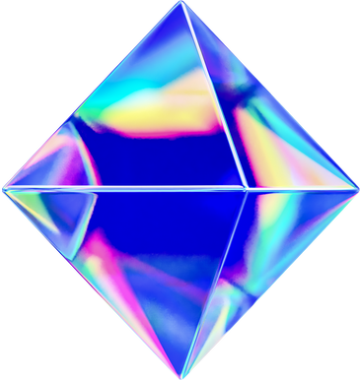




DIGITAL PORTFOLIO
BY DHARSHINI

Slide 2


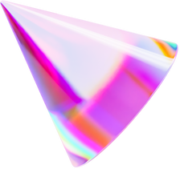

DIGITAL PORTFOLIO
STUDENT : DHARSHINIL.K
REGISTER NO / NMID NO : 92997FE99A7172592454B9B5D11F3308
DEPARTMENT : II Bsc ARTIFICIAL INTELLIGENCE
COLLEGE : ISLAMIAH WOMENS ARTS AND SCIENCE COLLEGE, VANIYAMBADI.
UNIVERSITY : THIRUVALLUR UNIVERSITY

Slide 3
PROJECT TITILE
STUDENT PORTFOLIO

Slide 4




AGENDA
PROBLEM STATEMENT
PROJECT TITLE
END USERS
TOOLS AND TECHNOLOGIES
PORTFOLIO DESIGN AND LAYOUT
FEATURES AND FUNCTINABILITY
RESULTS AND SCREENSHOT
CONCLUSION
GITHUB LINK

Slide 5
PROBLEM STATEMENT
Students often struggle to showcase their academic background, skills, and projects in a professional and organized way. A simple personal portfolio website can act as an online resume, allowing them to present their information clearly. The goal of this project is to design and develop a responsive student portfolio website using HTML, CSS, and JavaScript that includes sections such as About Me, Skills, Projects, and a Contact Form.

Slide 6
PROJECT OVERVIEW
In today’s digital world, having an online presence is essential for students to showcase their academic profile and technical skills. Traditional resumes are static and lack interactivity, while a web-based portfolio provides a dynamic way to highlight achievements, skills, and projects. This project focuses on creating a personal portfolio website using HTML, CSS, and JavaScript, enabling students to present their information professionally and connect easily through a contact form.

Slide 7
END USERS
AThe primary end users of this student portfolio website are recruiters, hiring managers, faculty members, and peers who want to learn about the student’s skills, projects, and achievements. It also benefits the student themselves, as it serves as a personal branding tool for internships, jobs, and academic opportunities.ng

Slide 8
TOOLS AND TECHNIQUES
This project is built using HTML for structuring the content, CSS for styling and layout design, and JavaScript for adding interactivity (like the contact form). A text editor such as VS Code is used for coding, and any modern web browser (Chrome, Edge, Firefox) is used to test and run the website.d

Slide 9
PORTFOLIO AND DESIGN LAYOUT
The portfolio has a clean, modern layout with a purple-themed header showing the student's name, course, and college. It includes sections for About Me, Skills, Projects, and a Contact form. Each section is neatly organized, with simple styling and smooth navigation. The design is responsive, easy to read, and uses minimal JavaScript for form validation.

Slide 10
FEATURES AND FUNCTIONALITY
This portfolio includes key features such as a responsive layout, navigation links for smooth section jumps, and a clean design using HTML and CSS. It has functional sections like About Me, Skills, and Projects to showcase the student's background and work. The Contact Me form includes basic JavaScript validation to check input fields and display a success message upon submission.
g

Slide 11
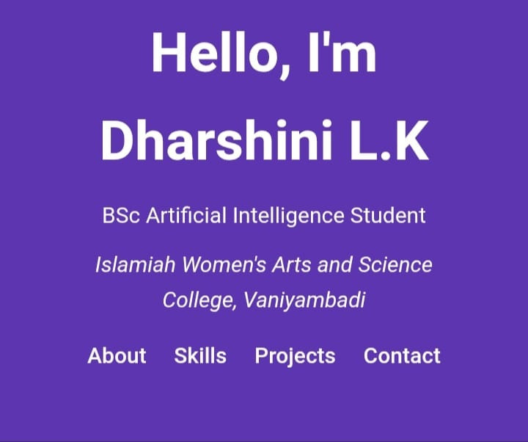
RESULTS AND SCREENSHOTS

Slide 12
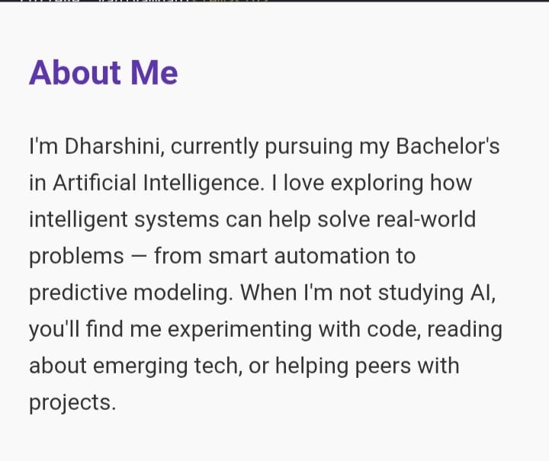
RESULT AND SCREENSHOT

Slide 13
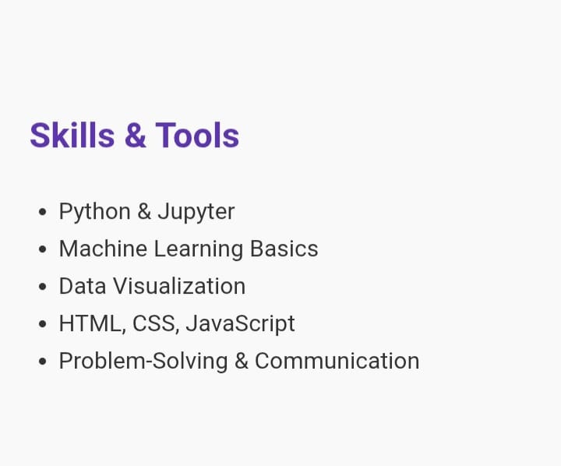
RESULTS AND SCREENSHOT

Slide 14
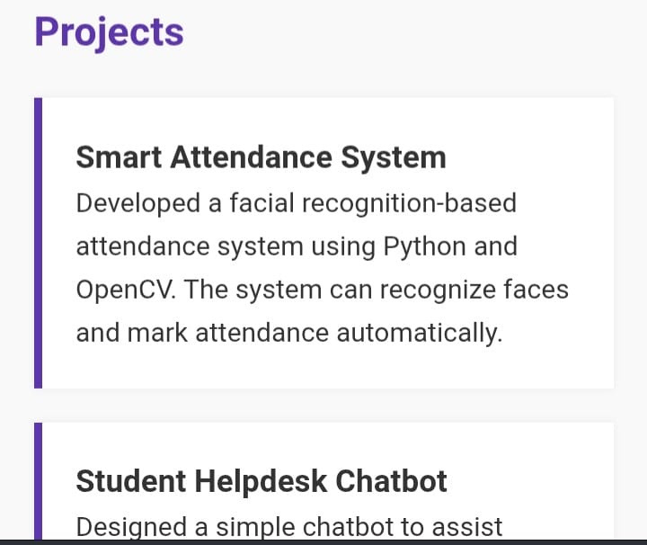
RESULTS AND SCREENSHOTS

Slide 15
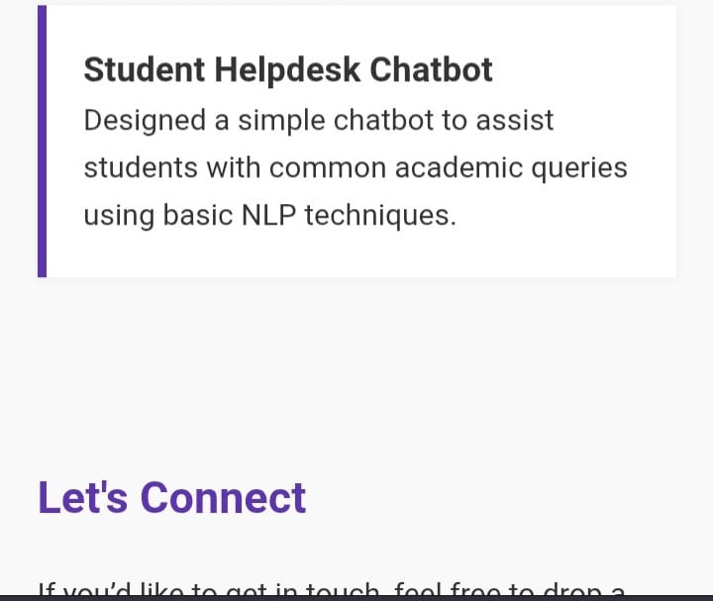
RESULTS AND SCREENSHOTS

Slide 16
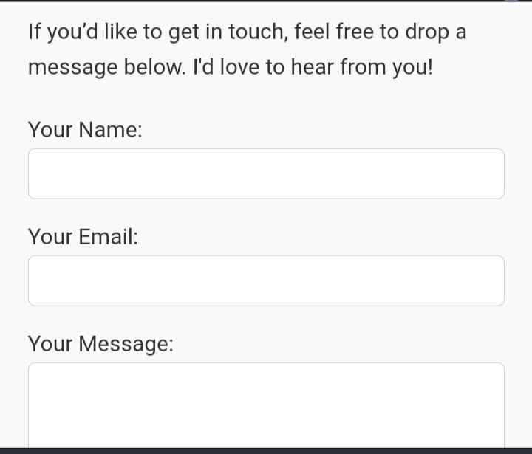
RESULTS AND SCREENSHOTS

Slide 17
CONCLUSION
This portfolio website effectively showcases the student's personal information, skills, and projects in a clean and organized layout. It provides a simple, user-friendly interface with responsive design and basic interactivity through JavaScript. Overall, it serves as a strong foundation for a personal web presence and can be expanded with more features in the future.
g

Slide 18
THANK YOU !!!

